Slide 1
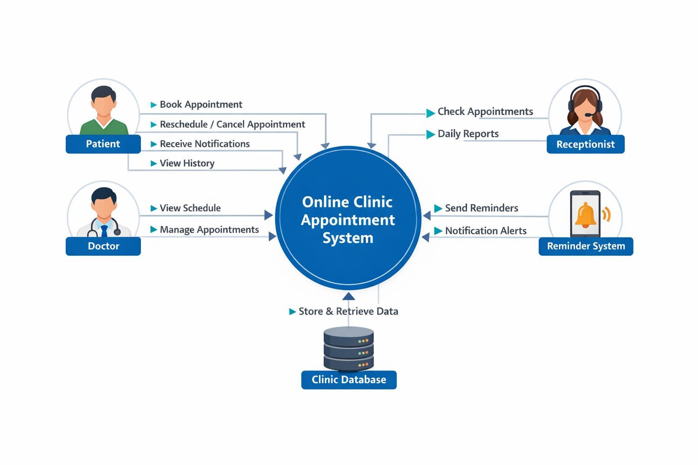
Context diagram for online clinic Appointment system
By Preethi(23FIS0606)| Sithum(23FIS0619)

Slide 2
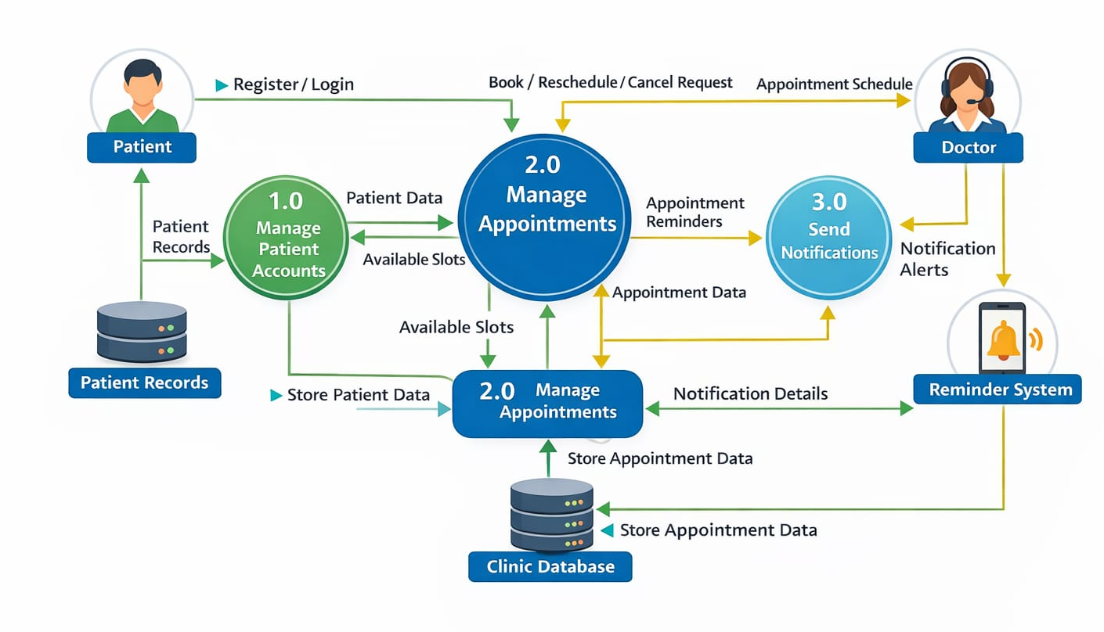
DFD diagram for online clinic Appointment system
By Preethi(23FIS0606)| Sithum(23FIS0619)

Slide 3
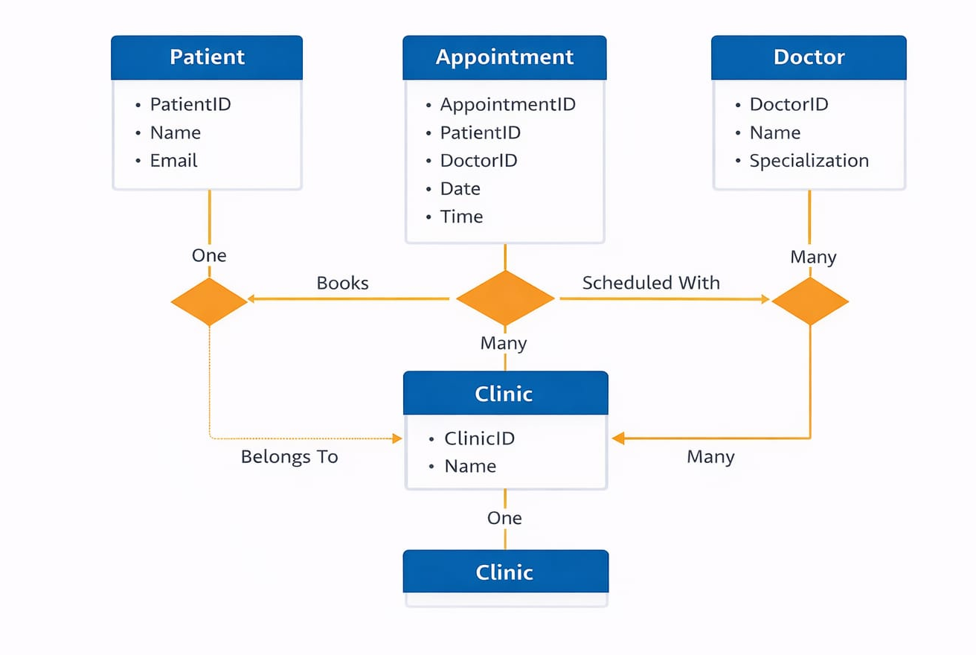
ER diagram for online clinic Appointment system
By Preethi(23FIS0606)| Sithum(23FIS0619)

